Slide 1

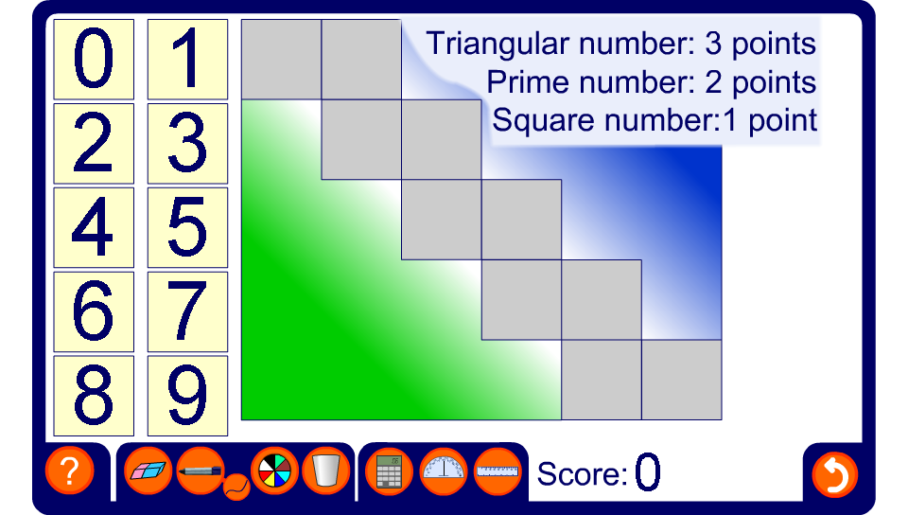


Squares, triangles and primes
Notes:
Discuss how the highest possible score can be achieved.

